Slide 1
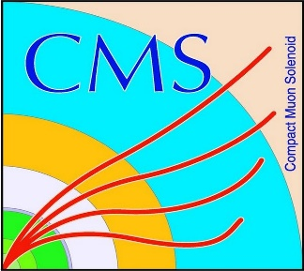

HEP Weekly Report
George Bakas
NTUA

Slide 2
Progress Report
DCS
CmsFwInstallUtils
Found a way to show the user where the inconsistencies are in case the tool doesn’t find the inconsistency correctly
Report button so that when a user finds a new problem with the tool he/she can send an email directly to the developers of the tool
Working on showing the user, what the info the user sees refers to (ex: ip address, driver number etc)
FwInstallationUtils
Improvements and fixes for the dbEditorAndNavigator tool
Analysis
Top Tagger
Comparisons between 2017 and 2016 MC using CSVv2
Comparisons between b-tagging methods (CSVv2 and deepCSV) for 2017 MC’s
Crab problems for the production of 2016 with deepCSV information
Top Angular Distributions
Have to decide which b-tagging method to use (deepCSV or CSVv2)
Working on the 2017 MC’s for calculating Efficiency/Acceptance, Response Matrices etc
Spin Correlations
No spin correlation Mtt sample will be ready probably next week (almost 92% ready)
Re-running code for regular sample→ fixes in the analyzer that I used and also in the codes that were running for calculating variables
ArdEnvino
Ordered screens for ArdEnvinoi
Started with printing some new Boxes

